Slide 1
Introduction to Computer Vision & CNNs

Slide 2
Learning Objectives
By the end of this session, participants will be able to:
Explain the core concepts and scope of computer vision
Understand how images are represented and processed by machines
Describe the structure and working principles of Convolutional Neural Networks (CNNs)
Apply basic CNN architectures for image classification tasks
Preprocess image data and prepare it for deep learning models
Build and evaluate a simple image classification model using Keras and TensorFlow

Slide 3
What is Computer Vision?

Slide 4
What is Computer Vision?
Computer vision (CV) is a field of artificial intelligence focused on enabling machines to interpret and understand visual information from the world. It involves processing images or videos to extract meaningful features and make decisions or predictions.
Applications range from object classification, detection, and segmentation to more advanced tasks like facial recognition, medical imaging analysis, and autonomous driving. CV relies on algorithms and models, especially convolutional neural networks, to learn patterns and representations from visual data.
Goal: Extract meaningful information from visual data to make decisions or take actions
Just like humans use eyes to understand the world, CV gives machines the ability to "see"

Slide 5
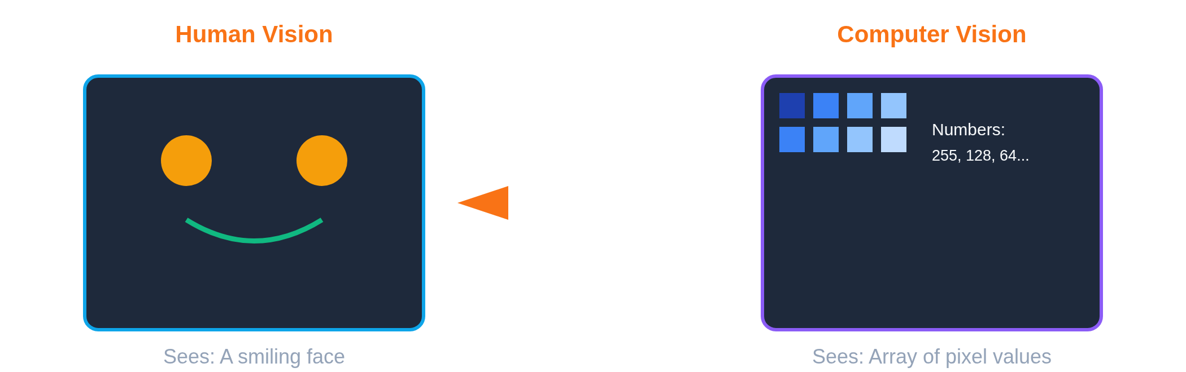
How Computers "See" Images
Computers interpret images as arrays of numerical values, where each pixel is represented by intensity values for one or more channels (e.g., grayscale or RGB). These arrays, also called image tensors, allow algorithms to perform mathematical operations to detect patterns, edges, and features.
Processing begins with basic pixel-level information, and higher-level structures such as shapes, textures, and objects are learned through layers in models like Convolutional Neural Networks (CNNs).

Slide 6
Brief History of Computer Vision
Computer vision began in the 1960s with simple image analysis and object recognition using basic rules. From the 1980s to the 1990s, research focused on feature extraction and early neural networks. In the 2000s, machine learning approaches started to advance image-related tasks. Since the 2010s, deep learning and convolutional neural networks (CNNs) have enabled high-accuracy recognition, detection, and segmentation.

Slide 7
Core Computer Vision Tasks
Computer vision focuses on several key tasks that enable machines to interpret visual data. Image classification assigns labels to entire images based on their content. Object detection identifies and locates multiple objects within an image. Image segmentation separates an image into meaningful regions or segments, often at the pixel level. Other tasks include facial recognition, pose estimation, and scene understanding, all of which extract structured information from raw visual data.
Classification
Detection
Segmentation
What is it?
What & Where?
Pixel-level
Dog, Cat, Bird
Find all objects
Precise boundaries
Face Recognition: Identify people
Motion Tracking: Follow movement
Optical Character Recognition: Read text
Image Generation: Create new images

Slide 8
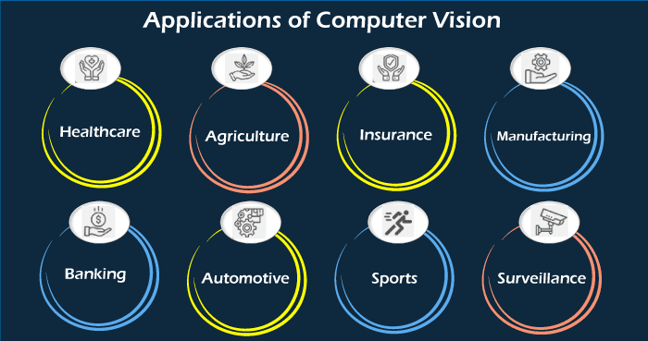
Computer Vision Applications
Everyday Life
Industries
Face unlock on phones
Photo organization
Social media filters
Self-driving cars
Security cameras
Healthcare diagnosis
Manufacturing QC
Retail checkout
Agriculture monitoring
Sports analytics

Slide 9
CV in Agriculture
Crop Health Monitoring: Detect diseases early using drone imagery
Pest Detection: Identify and count insects threatening crops
Yield Prediction: Estimate harvest output by counting fruits
Automated Harvesting: Robots identify ripe produce
Weed Detection: Target herbicide application precisely
Livestock Monitoring: Track animal health and behavior

Slide 10
CV in Healthcare
Medical Imaging: Analyze X-rays, MRIs, CT scans
Disease Detection: Identify cancer, tumors, abnormalities
Surgical Assistance: Guide procedures with real-time imaging
Patient Monitoring: Track vital signs and movement
Skin Analysis: Detect melanoma and skin conditions
Retinal Screening: Diagnose diabetic retinopathy

Slide 11
CV in Manufacturing & Retail
Manufacturing
Retail
Defect inspection
Quality control automation
Safety monitoring
Assembly verification
Predictive maintenance
Self-checkout systems
Inventory tracking
Customer analytics
Product recognition
Loss prevention

Slide 12
Nigerian CV Opportunities
Agriculture: Cassava disease detection, yam quality grading
Healthcare: Malaria diagnosis, TB screening in remote areas
Security: Crowd monitoring, facial recognition systems
Transportation: Traffic monitoring, accident detection
Education: Automated attendance, exam proctoring
Retail: Contactless shopping, inventory management

Slide 13
Convolutional Neural Networks
The Backbone of Modern Computer Vision

Slide 14
Why CNNs for Images?
Convolutional Neural Networks are specifically designed to process image data efficiently. They automatically learn spatial hierarchies of features, from simple edges to complex patterns, without manual feature engineering. CNNs exploit parameter sharing and local connectivity, reducing the number of parameters and computational cost. They are robust to translations and distortions in images, making them highly effective for tasks like classification, detection, and segmentation.
CNN Solutions:
Parameter sharing: Use same filter across image
Spatial structure: Preserve pixel relationships
Translation invariance: Detect features anywhere

Slide 15
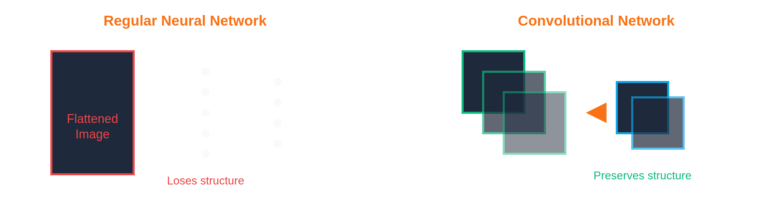
Regular NN vs CNN
Regular neural networks (fully connected networks) treat all input features equally and require flattening of image data, which can lead to a large number of parameters and loss of spatial information. CNNs, in contrast, preserve the spatial structure of images through convolution and pooling layers. They use local receptive fields and shared weights to efficiently detect patterns and features, making them more effective and scalable for image-related tasks.

Slide 16
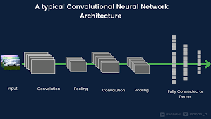
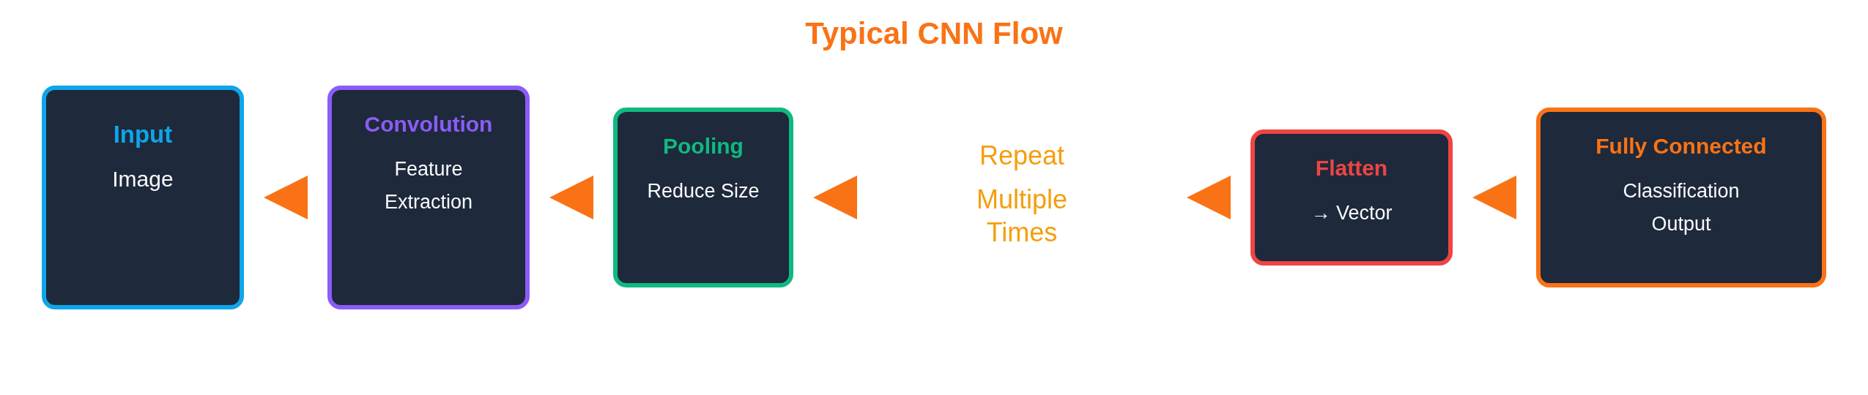
CNN Architecture Overview
A typical Convolutional Neural Network consists of a sequence of layers that progressively extract higher-level features from images. Convolution layers apply filters to detect patterns such as edges or textures. Activation functions introduce non-linearity, enabling the network to model complex relationships. Pooling layers reduce spatial dimensions and help prevent overfitting. Finally, fully connected layers map the extracted features to output classes for classification or other tasks. This layered structure allows CNNs to learn hierarchical representations efficiently.

Slide 17

Convolution Operation
Convolution is the core operation in CNNs where a filter (or kernel) slides over an image to extract features. Each filter highlights specific patterns, such as edges, textures, or shapes, producing a feature map that represents the presence and location of those patterns. By stacking multiple convolution layers, CNNs can learn increasingly complex features, enabling accurate image understanding and classification.

Slide 18
What Do Filters Detect?
Early layers learn simple features:
Edges: Horizontal, vertical, diagonal lines
Colors: Specific color blobs and gradients
Textures: Simple patterns and textures
Deeper layers learn complex features:
Shapes: Circles, curves, corners
Parts: Eyes, wheels, windows
Objects: Entire faces, cars, animals

Slide 19
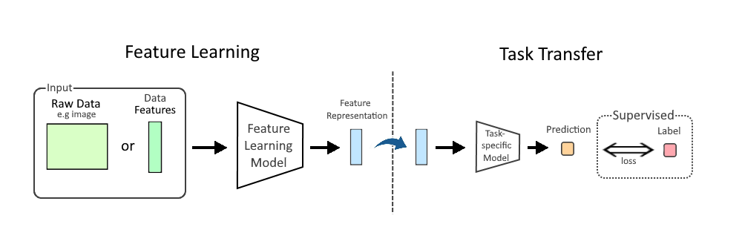
Hierarchical Feature Learning
CNNs learn features in a hierarchical manner. Early layers capture low-level patterns such as edges and textures. Intermediate layers combine these patterns into more complex structures like shapes or object parts. Deeper layers represent high-level, abstract features, enabling the network to recognize entire objects or scenes. This layered approach allows CNNs to progressively understand images from simple to complex representations.

Slide 20
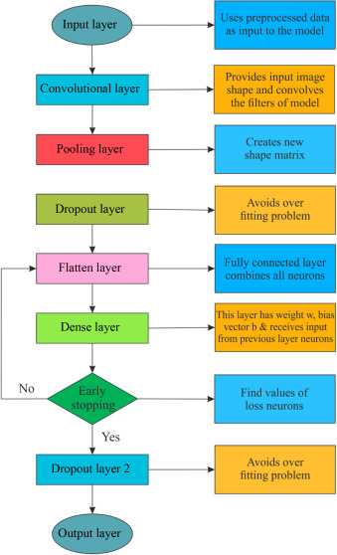
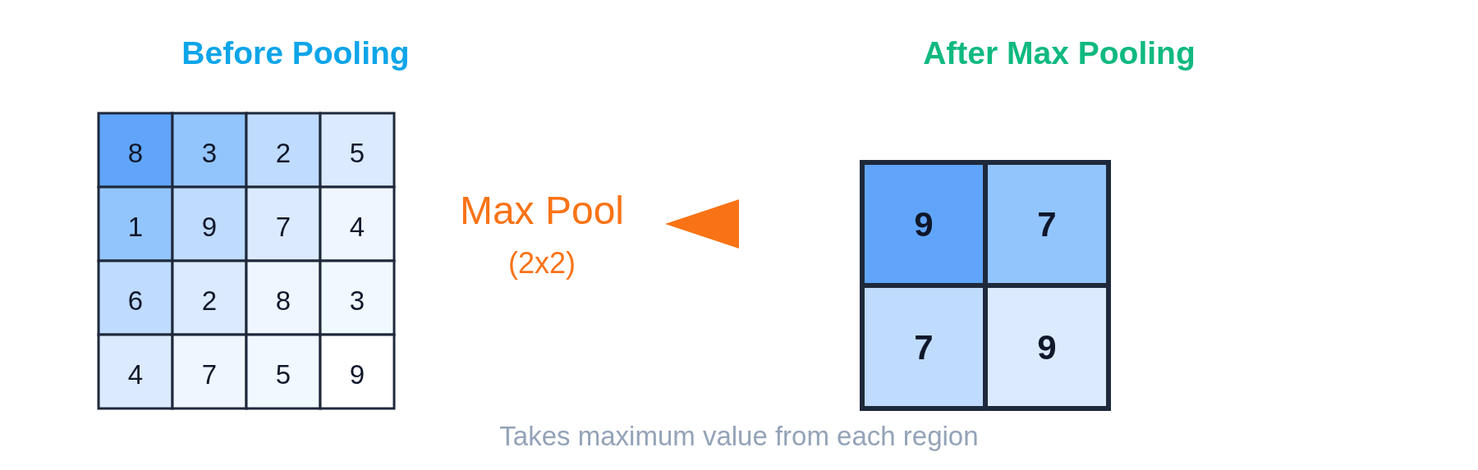
Pooling Layers
Pooling layers reduce the spatial size of feature maps while retaining the most important information. They help decrease computational complexity, control overfitting, and make the model more robust to small spatial changes in the input. Common pooling methods include max pooling, which keeps the strongest feature responses, and average pooling, which computes the average value within a region. Pooling enables CNNs to focus on dominant features rather than exact pixel locations.

Slide 21
Why Use Pooling?
Dimensionality Reduction: Smaller feature maps → fewer parameters
Translation Invariance: Small shifts don't matter
Computational Efficiency: Faster training and inference
Overfitting Prevention: Reduces model complexity
Types of Pooling:
Max Pooling: Takes maximum value (most common)
Average Pooling: Takes average value

Slide 22
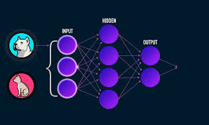
Activation Functions in CNNs
Activation functions introduce non linearity into CNNs, allowing the network to learn complex patterns beyond simple linear relationships. They determine which features are activated and passed to the next layer. The most commonly used activation function in CNNs is ReLU, which helps reduce vanishing gradient issues and speeds up training. Activation functions enable CNNs to model real world visual patterns effectively.
ReLU (Most Common)
Others
Rectified Linear Unit
Sigmoid: Output 0-1
Negative → 0
Tanh: Output -1 to 1
Positive → keeps value
Leaky ReLU: Small negative slope
Fast, effective

Slide 23
Parameter Sharing
Key Insight: Same filter applies to entire image
One 3x3 filter = only 9 parameters, regardless of image size!
Efficiency: Drastically fewer parameters than fully connected
Translation Invariance: Detect features anywhere in image
Scale: Works on images of any size
Example: 64 filters of 3x3 = 576 parameters vs millions in fully connected!

Slide 24
Famous CNN Architectures
Evolution of Deep Learning for Vision

Slide 25
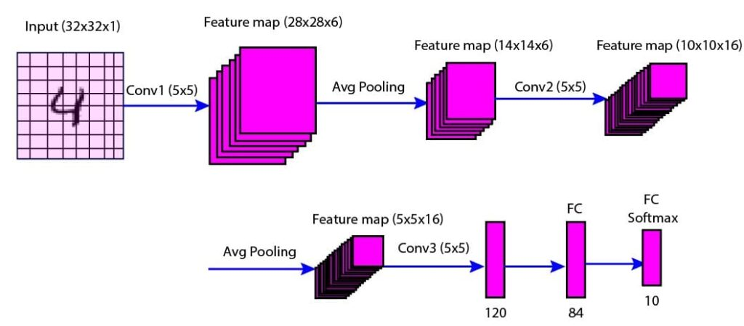
LeNet-5 (1998)
LeNet 5 is one of the earliest convolutional neural networks and was designed primarily for handwritten digit recognition. It introduced the core CNN structure of alternating convolution and pooling layers followed by fully connected layers. LeNet 5 demonstrated that convolutional networks could automatically learn useful features from images, laying the foundation for modern deep learning based computer vision models.
First successful CNN: Used by banks to read checks
Architecture: 7 layers total
Innovation: Proved CNNs work for real applications
Small by today's standards but revolutionary

Slide 26
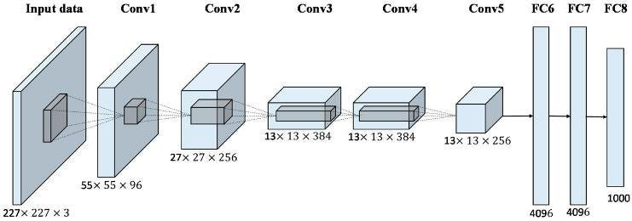
AlexNet (2012)
AlexNet marked a major breakthrough in computer vision by dramatically improving image classification performance in the ImageNet competition. It demonstrated the power of deep convolutional networks trained on large datasets using GPUs. AlexNet introduced key ideas such as ReLU activation, dropout for regularization, and deeper network architectures, which became standard practices in modern CNN design.
8 layers: 5 convolutional + 3 fully connected
60 million parameters
Innovations: ReLU, Dropout, GPU training
Reduced error from 26% to 15% on ImageNet

Slide 27
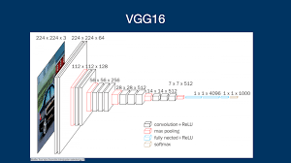
VGG (2014)
VGG introduced deeper convolutional neural networks using a simple and consistent architecture based on small 3×3 convolution filters. By increasing depth while keeping the design uniform, VGG achieved improved accuracy in image classification tasks. Its straightforward structure made it highly influential and widely used as a backbone for many modern computer vision models.
VGG-16: 16 layers, VGG-19: 19 layers
Simple architecture: Only 3x3 filters
138 million parameters
Very deep, uniform structure
Still widely used for transfer learning

Slide 28
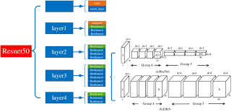
ResNet (2015)
ResNet addressed the challenge of training very deep neural networks by introducing residual connections, which allow information to flow directly across layers. These skip connections help prevent vanishing gradients and enable the training of extremely deep models with improved accuracy. ResNet significantly advanced computer vision performance and remains a foundation for many modern deep learning architectures.
Residual Learning: Learn difference from identity
Skip Connections: Direct paths through network
Won ImageNet 2015
Revolutionary architecture still dominant today

Slide 29
Modern Architectures
Modern computer vision architectures focus on improving accuracy, efficiency, and scalability. Models such as Inception optimize computation through multi scale feature extraction, while MobileNet and EfficientNet are designed for lightweight and resource constrained environments. Recent approaches also include transformer based models, which capture global image relationships more effectively. These architectures enable high performance vision systems across mobile, cloud, and real time applications.
Inception (GoogLeNet)
EfficientNet
Multiple filter sizes in parallel
Optimally scales depth, width, resolution
Efficient with fewer parameters
State-of-the-art efficiency
MobileNet
Vision Transformers
For mobile/edge devices
Attention-based (newer approach)

Slide 30
Working with Image Data
Preprocessing & Data Loading

Slide 31
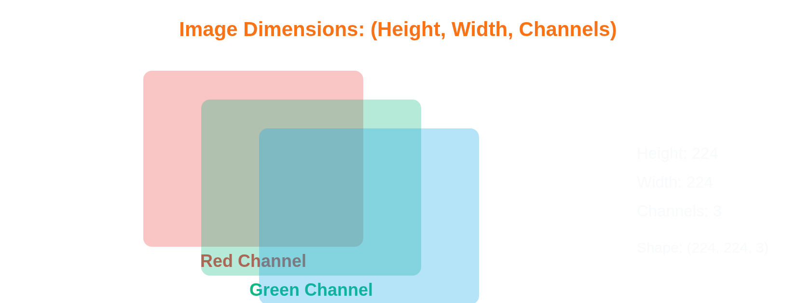
Understanding Image Tensors
Images are represented in deep learning as tensors, which are multi dimensional arrays of numerical values. A typical image tensor is structured as height × width × channels, where channels represent color information such as grayscale or RGB. This tensor format allows neural networks to perform mathematical operations for feature extraction and pattern learning. Understanding image tensors is essential for preprocessing, model design, and debugging computer vision systems.

Slide 32
Image Preprocessing Steps
Resizing: Make all images same dimensions (e.g., 224x224)
Normalization: Scale pixel values to 0-1 or standardize
Data Augmentation: Rotation, flipping, zooming
Color Conversion: RGB, grayscale conversions
Cropping: Center crop, random crop
Why preprocess? Consistent input, better training, prevent overfitting

Slide 33
Image Normalization
Image normalization scales pixel values to a standard range, usually between 0 and 1 or around a mean of zero. This process improves training stability and helps neural networks learn more efficiently. Normalization reduces the effect of lighting variations and ensures that all input features contribute proportionally during model training, leading to faster convergence and better performance.
Min-Max Scaling
Standardization
Pixel values: 0-255
Subtract mean
Divide by 255
Divide by std dev
Result: 0.0-1.0
Result: Mean=0, Std=1
Simple, common
ImageNet standard

Slide 34
Data Augmentation
Data augmentation generates additional training images by applying transformations such as rotation, flipping, scaling, cropping, or color adjustments. This technique increases dataset diversity, reduces overfitting, and improves model generalization. By simulating real-world variations, augmentation helps CNNs become more robust to changes in object orientation, lighting, and background.
Create variations of training images to prevent overfitting
Geometric
Photometric
Advanced
Rotation, Flipping
Brightness, Contrast
Cutout, Mixup
Zooming, Shifting
Saturation, Hue
CutMix, AutoAugment
Benefit: More training data without collecting new images!

Slide 35
Loading Image Datasets
Direct Loading: For small datasets (all fit in memory)
Data Generators: Load batches on-the-fly (large datasets)
ImageDataGenerator: Built-in augmentation capabilities
Custom Datasets: Full control over loading process
Best Practice: Use generators for scalability - load images in batches during training

